Slide 1



Java Enterprise Edition
Session
6
Chaim Turkel
Ido Barash

Slide 2


Java EE
Java Platforms
What is Java EE?
Some Specifications
JCP
JEE components
n-tier architecture
JEE Containers
Application servers
Deployment
Servlets specification

Slide 3

Java Platforms
Java technology is both programming language and a platform.
A platform is an environment in which Java applications can run.
There are several java platforms:
Java SE Standard Edition.
Java EE Enterprise Edition
Java ME Micro Edition
All Java platforms contain JVM and an API

Slide 4
Java Platforms
Java SE: Provide the core functionality of the Java language. Defines everything from the basic primitive types up to networking, security, GUI, etc..
Java EE: An extension to the Java SE platform. Provide extra APIs to develop large-scale, multi-tiered network applications.
Java ME: Provide thinner API for small devices and mobile phones. This platform is “kind of deprecated” since Android arrival.

Slide 5
What is Java EE?
Java EE is a set of definitions and best-practices that are meant to simplify the way we develop Java enterprise systems.
Basically, these definitions provide a component based approach to design, development, assembly and deployment of Java systems.
These definition form an open standard for the industry.
These definitions are basically interfaces and best-practices and they are called: SPECIFICATIONS.
Notes:
Java ee – enterprise edition, java se – standard edition, java me – mobile edition (deprecated)
Use to be j2ee up to 1.4
Expansion for java se
5

Slide 6
What is Java EE?
The mission of JEE is to provide a platform-independent, portable, multi-user and secure server side systems.
This is done by implementing component’s specifications.
As we use Java implemented Collections and data-structures, we use JEE implemented components for every purpose.
JEE was also called J2EE till version 4.

Slide 7
Some specifications
JAX-B: Java API for XML Binding. Defines how an object is serialized to XML.
JAX-RS: Java API for XML Rest services Defines how to implement Rest services
JAX-WS: Java API for XML Web services Defines how to implement web services
JTA: Java Transactions API Defines how to work with transactions
JPA: Java Persistency API Defines how to work with DB

Slide 8
Some specifications
AppServer: Defines how to create an application server.
Servlet engine: Defines how to handle requests, and return responses to client.
JMS: Java Messaging Service Defines how to send messages with MQ.
EJB: Entity Java Beans
JSF: Java Server Faces Defines how to create client side views

Slide 9
JCP
A specification is created by the JCP (Java community process)
The JCP is a mechanism that allows interested parties to develop and submit new Java specifications and technology.
Anyone can become a member of the JCP (Open source).
A member of the JCP can submit a JSR (Java specification request) which is a formal document specifying the specification.
After a JSR was submitted, other members of the JCP return feedback.

Slide 10
JCP
When the JSR is ready, the JCP Executive Committee will vote on it. The committee is a small counsel which includes 16 voting seats.
The EC includes members of the biggest Java vendors such as IBM, Oracle, Red-hat, HP & Fujitsu.

Slide 11
JEE component
A component is a self contained functional software unit that responsible of a very specific job.
JEE component uses other relative JEE components to perform extra functionality.
JEE component can be used by other JEE components, which can perform it’s functionality.
A Java bean is a component with private members, getters and setters – which forms “properties”.

Slide 12








n-tier architecture
Best practice for Enterprise applications design:
Client
Machine
App client
Dynamic HTML
Client tier
JSP / JSF / WS / Servlet
Web tier
JEE Application
Server
Enterprise beans
Enterprise beans
Business tier
EIS tier
Other Servers
Databases
Legacy
LDAP
Notes:
Session beans, entity beans
12

Slide 13
Client components
Web-client such as: - Dynamic web pages generated by the web components of the WEB tier. - applets - HTML thin clients.
Application client - Java app that runs on the client machine, probably has GUI written in Swing or JSF.
A client may also include java beans to connect directly with the business tier.

Slide 14
Web Components
Servlets: A Java classes that dynamically process requests and construct responses.
JSP files: Java server pages are HTML files with java code that are translated servlets in runtime.
JSF files: Java Server Faces technology which extends the JSP abilities and provides more powerful user interface.
Applets and HTML static pages are bundled with the web components when the app is assembled but are not considered to be web components.

Slide 15
Business Components
Business code the solves or meets the needs of the business domain.
Classes and services that truly represents the business of the system.
Handled by enterprise beans.
Can have multiple logical layers
Business components can use other business components.

Slide 16




Business Components
Business code the solves or meets the needs od the business domain.
Classes and services that truly represents the business of the system.
Handled by enterprise beans.
Can have multiple logical layers
Business components can use other business components.
Clients servlet
Web tier
Client services
Business
tier
Client DB handler
Database
EIS tier

Slide 17
EIS Components
Enterprise Infrastructure Services
Databases
ERP
LDAP
Active Directory
Legacy systems

Slide 18
JEE Containers
Writing a full multi-tiered app is complicated.
We need: transactions support, state management, resource handling and more…
Containers are the interfaces between a JEE component and a low level resources.
Containers are “configuration based” and they can act differently for each JEE-App.

Slide 19
Application Servers
Run time environment for Java application
Provide implementations to all JEE specifications from J2EE – JEE 7

Slide 20




Application Servers
Run time environment for Java application
Provide implementations to all JEE specifications from J2EE – JEE 7

Slide 21
Application Servers
Run time environment for Java application
Provide implementations to all JEE specifications from J2EE – JEE 7
Web-servers – Provide implementations to the JSP and servlet engine specifications only. Usage of other specs requires an external JAR with the implementation.

Slide 22


Application Servers
Run time environment for Java application
Provide implementations to all JEE specifications from J2EE – JEE 7
Web-servers – Provide implementations to the JSP and servlet engine specifications only. Usage of other specs requires an external JAR with the implementation.

Slide 23
Deployment
Java bytecode can be wrapped in 3 ways – all of them zip with a different extension.
JAR Java Archive. Contains enterprise beans, utils, etc..
WAR Web Archive. Contains servlets, JSPs, web resources (JPG, HTML) and jars. Includes a web.xml file. WAR files are deployed to web-servers.
EAR Enterprise Archive – Contains all of the above including jar and war files. EAR files are deployed to Application servers.
Notes:
War can contain jar …
23

Slide 24
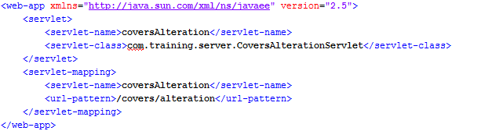
Web-app Standard
Deployment descriptor – web.xml
Java web applications use the deployment descriptor to determine how URLs are mapped to servlets.
The web.xml Must be under the folder: webapp/WEB-INF
Web.xml is part of the standard for web-apps.

Slide 25
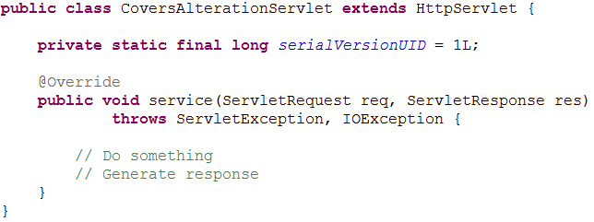
Servlets specification 2.5
Servlet: An entry point to the app. A class that handle requests and generate a response.
Servlet class must extend HttpServlet and override service callback method or HTTP methods handlets.
Servlet class must be mapped to URL in the web.xml

Slide 26
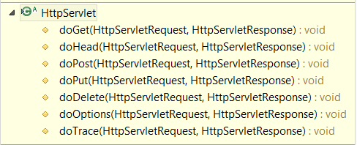
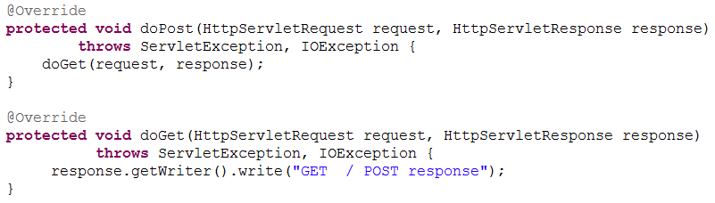
Servlets specification 2.5
HttpServlet class comes with default method you can override to perform different HTTP tasks:

Slide 27
Servlets specification 2.5
Exercise:
Connect eclipse with your local tomcat.
Create a new “Dynamic Web project”.
Create a new servlet (2.5) which on GET: prints “Got GET”. POST: prints “Got POST”.
Map it to Url: “/hello”.
Check it.

Slide 28
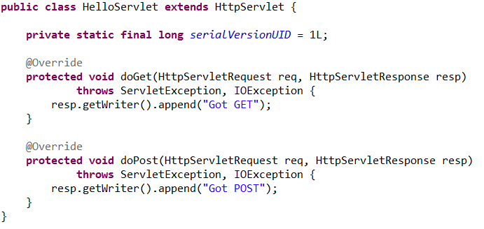
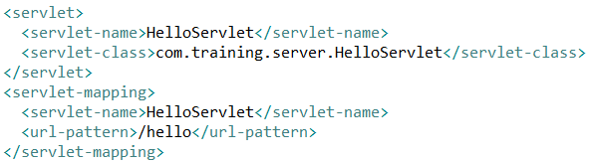
Servlets specification 2.5

Slide 29
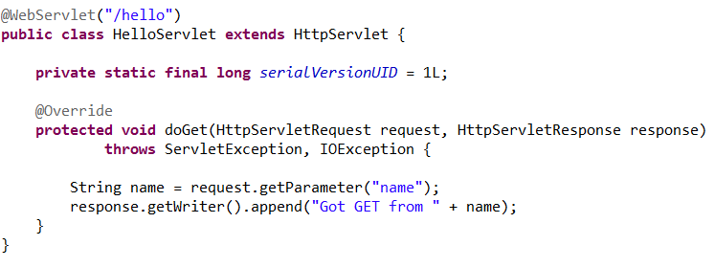
Servlets specification 3.0
Faster and easier - No mapping in web.xml
Requires only a class extending HttpServlet and special annotation: @WebServlet(“/hello”)
Example of simple servlet using a parameter:

Slide 30
Servlets specification 3.0
Exercise:
Use your dynamic web project from last exercise.
Create a new servlet (3.0) which on POST and GET : receives numbers in the query string and calculates their average.
Design multi-layered app with different packages per layer.
Use a singleton to calculate average.
Check it:

Slide 31
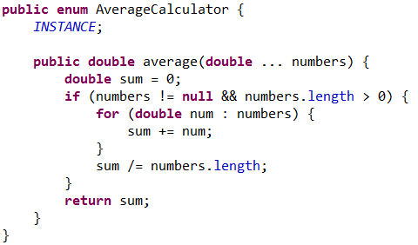
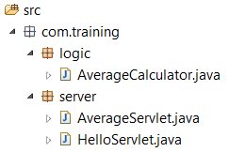
Servlets specification 3.0

Slide 32
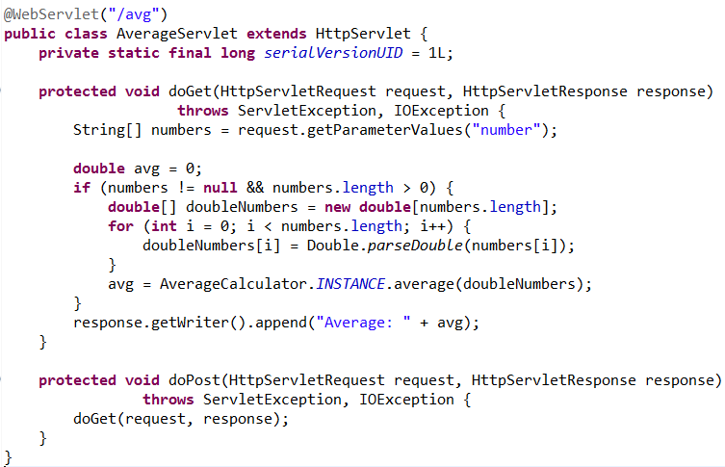
Servlets specification 3.0

Slide 33
Java EE
Java Platforms
What is Java EE?
Some Specifications
JCP
JEE components
n-tier architecture
JEE Containers
Application servers
Deployment
Servlets specification

Slide 34
Next session - Maven
What is maven
Dependency management
Build process management
Continues Integration
Repositories
Jenkins
Session
7

Slide 35

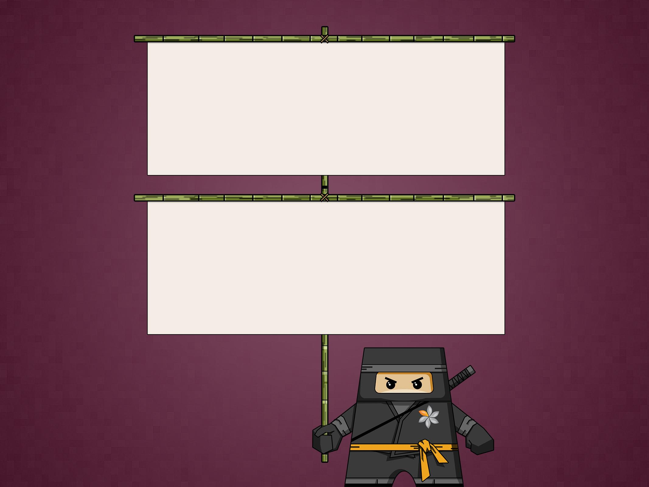
THANK YOU
Ido Barash
Email: ido.barash@tikalk.com

